Slide 1
The ExecutorService, Future, and Callable are Java concurrency concepts that provide a high-level abstraction for executing tasks asynchronously and obtaining their results.

Slide 2
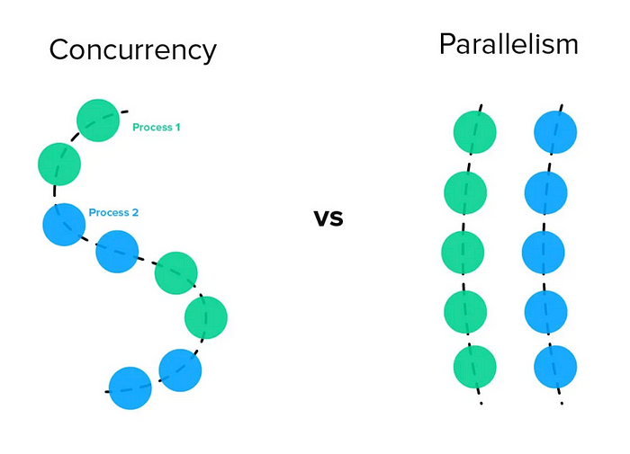

Slide 3
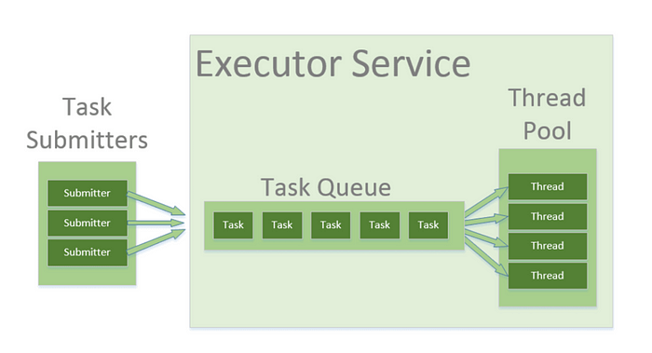
ExecutorService:
An ExecutorService is a utility in Java that provides a way to execute tasks concurrently.
It manages a pool of worker threads, and allows you to submit tasks for execution.
The ExecutorService handles creation, management, and reusability of threads, making it easier to handle concurrent tasks in multithreaded applications

Slide 4
Example
import java.util.concurrent.ExecutorService;
import java.util.concurrent.Executors;
public class ExecutorServiceEx {
public static void main(String[] args) {
ExecutorService executorService = Executors.newFixedThreadPool(2);
// Submit tasks for execution
executorService.submit(() -> {
System.out.println("Task 1 executing");
});
executorService.submit(() -> {
System.out.println("Task 2 executing");
});
// Shutdown the executor service
executorService.shutdown();
}
}

Slide 5
In above code, an ExecutorService is created using the Executors.newFixedThreadPool() factory method, which creates a thread pool with a fixed number of threads (2 in this case).
Two tasks are submitted using the submit() method, which queues the tasks for execution.

Slide 6
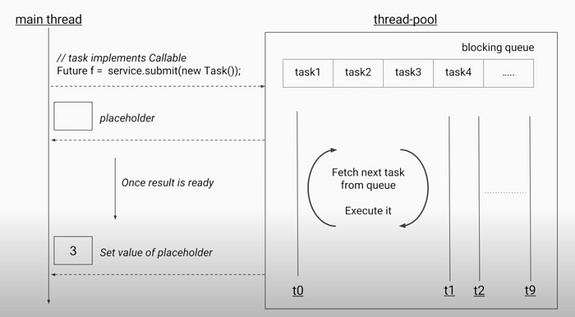
Future
The Future interface represents the result of an asynchronous
It provides methods to check if the computation is complete, wait for the result, and retrieve the result

Slide 7
import java.util.concurrent.*;
public class FutureEx{
public static void main(String[] args) throws InterruptedException, ExecutionException {
ExecutorService executorService = Executors.newSingleThreadExecutor();
// Submit a task and obtain a Future object
Future<String> future = executorService.submit(() -> {
Thread.sleep(2000);
return "Hello, Future!";
});
// Perform other tasks while the computation is in progress
// Wait for the result and retrieve it
String result = future.get();
System.out.println(result);
// Shutdown the executor service
executorService.shutdown();
}
}

Slide 8
Callable:
The Callable interface is similar to the Runnable interface but represents a task that returns a result.
It is used in conjunction with the ExecutorService and Future to execute tasks asynchronously and obtain their results.

Slide 9
import java.util.concurrent.*;
public class CallableEx {
public static void main(String[] args) throws InterruptedException, ExecutionException {
ExecutorService executorService = Executors.newSingleThreadExecutor();
// Submit a task and obtain a Future object
Future<Integer> future = executorService.submit(new Callable<Integer>() {
@Override
public Integer call() throws Exception {
Thread.sleep(2000);
return 42;
}
});
// Perform other tasks while the computation is in progress
// Wait for the result and retrieve it
Integer result = future.get();
System.out.println(result);
// Shutdown the executor service
executorService.shutdown();
}
} output :42

Slide 10
Here, a Callable<Integer> object is created and submitted to the executor service using the submit() method.
The call() method of the Callable interface is implemented to perform the computation and return a result.
The result is retrieved using the get() method of the Future object. Finally, the executor service is shut down.
PS : The Callable interface is parameterized with the type of the result it produces. For example, Callable<Integer> indicates that the task will return a result of type Integer.
Callable vs Runnable ??
Both Runnable and Callable are interfaces that represent tasks or units of work that can be executed concurrently. They are used with concurrency utilities like ExecutorService to submit tasks for execution.
The most significant distinction between Runnable and Callable is that Runnable does not return a result or value, while Callable can return a result.
Also the Runnable interface's run() method cannot throw any checked exceptions directly. On the other hand, the call() method of the Callable interface is allowed to throw checked exceptions.

